Slide 1
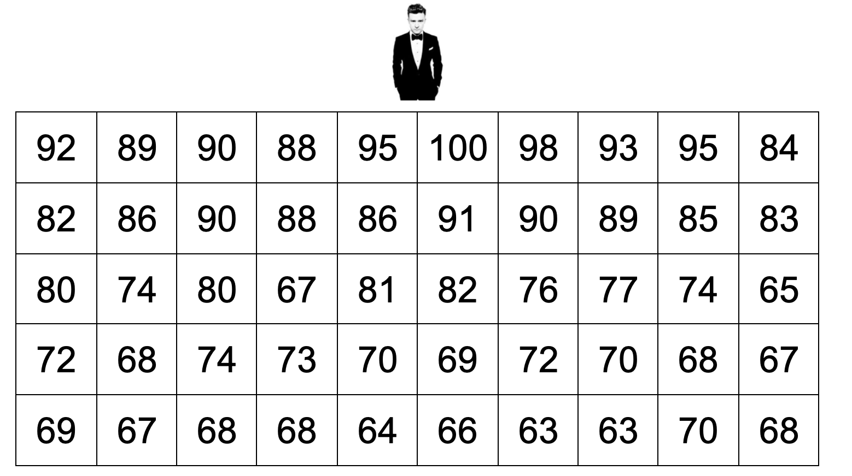

Slide 2
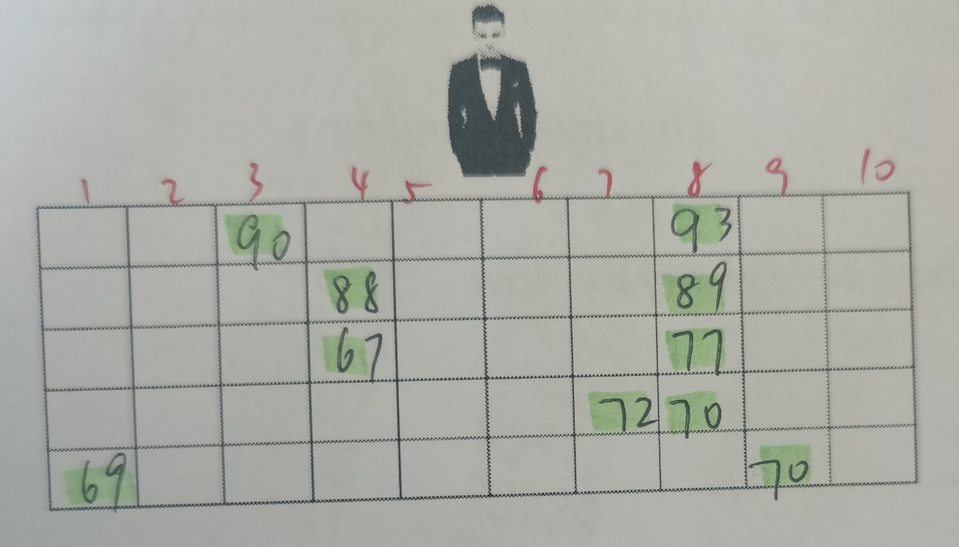
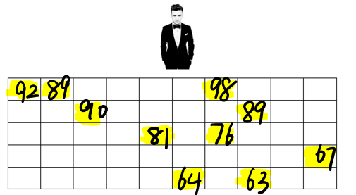

# 1
# 2
# 3

Slide 4
Method # | Sample mean | Sample standard deviation
1 | 81.1 | 12.42
2 | 78.5 | 10.29
3 | 79.1 | 12.01

Slide 5
Method # | Sample mean | Sample standard deviation
1 | 81.1 | 12.42
2 | 78.5 | 10.29
3 | 79.1 | 12.01

Slide 6
Method # | Sample mean | Sample standard deviation
1 | 81.1 | 12.42
2 | 78.5 | 10.29
3 | 79.1 | 12.01
Why ?
We should choose strata based on characteristics that may affect responses.

Slide 7
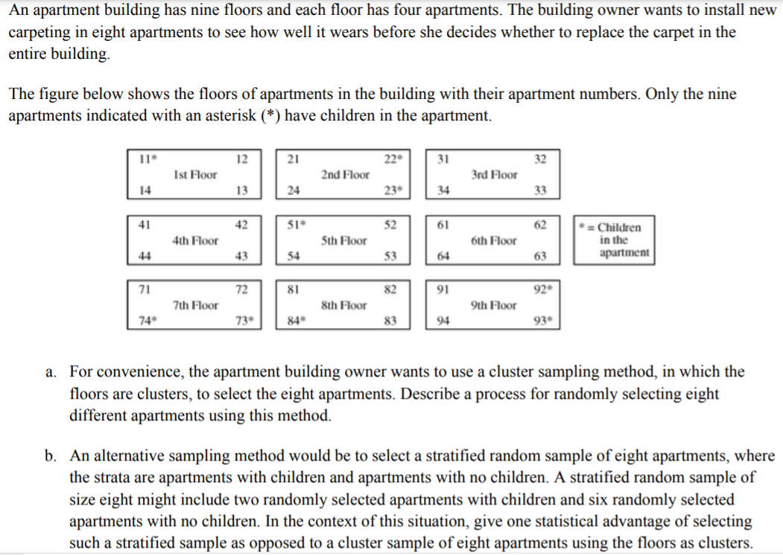

Slide 8
The following two-step process can be used to select the eight apartments.
Step 1: Generate a random integer between 1 and 9, inclusive, using a calculator, a computer program, or a table of random digits. Select all four apartments on the floor corresponding to the selected integer.
Step 2: Generate another random integer between 1 and 9, inclusive. If the generated integer is the same as the integer generated in step 1, continue generating random integers between 1 and 9 until a different integer appears. Again select all four apartments on the floor corresponding to the second selected integer.
The cluster sample consists of the eight apartments on the two randomly selected floors.

Slide 10
Because the amount of wear on the carpets in apartments with children could be different from the wear on the carpets in apartments without children, it would be advantageous to have apartments with children represented in the sample. The cluster sampling procedure in part (a) could produce a sample with no children in the selected apartments; for example, a cluster sample of the apartments on the third and sixth floors would consist entirely of apartments with no children. Stratified random sampling, where the two strata are apartments with children and apartments without children, guarantees a sample that includes apartments with and without children, which, in turn, would yield sample data that are representative of both types of apartments.

